Slide 1

Formal Metrics for Large-Scale Parallel Performance
ISC 2015
Kenneth Moreland and Ron Oldfield
Sandia National Laboratories
Notes:
This paper is really about first principles for visually analyzing parallel algorithm performance with charts
The effectiveness of charts is contingent on the metric used so we talk mostly about that
Start by reviewing the standard metrics used to measure parallel algorithm performance

Slide 2
Parallel Algorithm Speedup
Notes:
The most basic metric is speedup, which tells you by what factor faster your algorithm runs by adding parallel processing
Speedup for a given problem size and number of processing elements (which I will call job size) is defined by the time running the algorithm in serial divided by the time running in parallel.

Slide 3

Parallel Algorithm Speedup
Serial time for large problem sizes
Cannot be measured in practice
Notes:
The problem with the speedup metric is that is relies on measuring the serial performance for the given problem size.
This is fine for theoretic analysis, but…
For any parallel problem of non-trivial size, it is simply not possible to empirically measure the serial performance.
If a problem is large enough to run on 100K processing elements, it could not possible fit in the memory attached to a single processor and would take decades to run.
Even if you tried, the differences in how the hardware is engaged would invalidate the comparison.
So in practice, there is no way to really use this metric.
In fact, this idea of the serial performance on impossible large problems permeates through almost every theoretic measurement.

Slide 4
Efficiency
Notes:
For example, there is efficiency, which measures how many more total compute cycles are used by a parallel algorithm.
But efficiency defined in terms of the speedup.

Slide 5
Efficiency
Notes:
And of course to measure the speedup you once again need this serial time measurement.

Slide 6
Karp-Flatt Metric
Notes:
Then there is the Karp-Flatt metric, which experimentally measures the serial fraction of the algorithm.
I’ve never seen this used in practice since you have to first measure the true speedup, which you cannot do.

Slide 7
Isoefficiency Metric
Notes:
The isoefficiency metric determines how much a problem size needs to grow to meet an efficiency target for a particular job size.
Yet the metric requires once again knowing the serial performance for the target problem size.
It’s also unclear how to measure the overhead, which is also required.
As with the other metrics, this is more useful for theoretical analysis than empirical.

Slide 8
Measuring Scalability in Practice
Strong Scaling: Behavior as processing elements are increased and problem size held constant.
Per Amdahl’s Law, strong scaling always has its limits.
Weak Scaling: Behavior as processing elements and job size are increased proportionally.
Per Gustafson-Barsis Law, weak scaling can possibly be increased indefinitely.
Scaling is often demonstrated with absolute run time over different scales.
Notes:
Scalability is the measure of the ability to increase performance as the number of processing elements increase
Scalability is what we are really after in HPC.

Slide 9
Demonstrating Strong Scaling
Notes:
A common approach to show the results of scaling is to show the trend of execution time as the number of processing elements is increased.
Perfect scaling (where doubling PE halves the run time) results in a hyperbolic curve as shown here.
So we are trained to look for this hyperbolic shape when looking at strong scaling results.
However, most parallel algorithms exhibit a similar shape even when the scaling is far from perfect.

Slide 10
Measuring Strong Scaling
O(n/p)
O(n/p + log p)
O(n/p + p)
Notes:
Here is a comparison of some theoretic scaling charts with very different overheads.
As you can see, the shape is almost identical.

Slide 11
Strong Scaling with Log Axes
Notes:
One way to alleviate the problem a bit is to change the scaling on the axes from linear to logarithmic
Logarithmic axes are usually used show data across multiple scales.
They also have the side effect of turning a hyperbolic curve into a straight line, which makes it easier to compare.
However, log axes also tend to hide large differences,
After all, a polynomial of any order is a straight line.

Slide 12
Measuring Strong Scaling with Log
O(n/p)
O(n/p + log p)
O(n/p + p)
Notes:
This situation is improved.
In particular, you can tell when the slope changes if you look closely.
However, the differences tend to look small, and the effect gets worse

Slide 13
Scaling with More Visual Precision
Our position statement: rate and efficiency better represent scaling behavior.
Although neither rate nor efficiency is a new concept, there is not a lot of consistency in the community.
Through algebra and examples I will show why rate and efficiency are the “right” metrics to use.

Slide 14
Rate
Notes:
First, let’s review what rate is.
Rate is a simple metric that is easy to measure.
It is the size of the problem divided by the time the problem ran.
It has units like “particles per second” or “blocks per minute” or even “bytes per second”
It is the throughput of the algorithm
So, I say rate is a better metric to show scaling. What makes this so?

Slide 15
Why Use Rate?
Notes:
Let’s go back to that the fundamental measurement of parallel algorithms is speedup.
But in an instance of cosmic irony we have no practical way to measure speedup.

Slide 16
Why Use Rate?
Notes:
But look what happens when we express speedup in terms of rate.
The speedup measurement still relies on the immeasurable serial time

Slide 17
Why Use Rate?
Becomes a constant with n is constant.
Notes:
But if we hold the size of the problem constant then this term becomes a constant.

Slide 18
Why Use Rate?
Notes:
So for a given problem size speedup is proportional to rate.
This means that the plots for speedup and rate are essentially identical.
The only difference is the units and numbers on the ordinate axis.
Thus, we can plot rate as a proxy for speedup and get the same benefit.

Slide 19
Scaling with Rate
Notes:
So a plot of rate with perfect scaling is a linear line.
This, of course, is the same shape as speedup.
The numbers I use here happen to be for strong scaling, but weak scaling happens to be exactly the same.
More on that later.

Slide 20
Measuring Scaling with Rate
O(n/p)
O(n/p + log p)
O(n/p + p)
Notes:
If we look again at our theoretic algorithm performance, we see that with rate it is easy to differentiate between them and to qualify scalability.

Slide 21
Measuring Scaling with Rate
O(n/p + log p)
O(n/p + p)
O(n/p + log p)
O(n/p + p)
Notes:
In particular if we compare against measuring with absolute run time we find rate much more expressive.

Slide 22
Efficiency
Notes:
I’ve also said that efficiency is a good metric to measure with and is one of the basic theoretical measure.
But I’ve also said that we cannot actually measure efficiency because it relies on serial performance.

Slide 23
Measuring Efficiency from Cost
Notes:
However, here is an alternate definition of efficiency that relies only on the best job that can be practically run.
We base this measure of efficiency on the cost of running the algorithm.
Cost is the well established theoretical measure that is the time to run times the number of processing elements used.
It has units like core hours
It also happens to be the unit used to charge use of most supercomputing facilities.
It has a lot of meaning in both theory and practice.

Slide 24
Measuring Efficiency from Cost
Minimum (best) cost
Notes:
Given a particular problem size, there will be some minimum cost at some number of processing elements
We label this C star
Any cost greater than that represents “wasted” compute cycles used for the calculation
We can define the efficiency as the ratio of optimal cost to measured cost
Theory assumes the optimal cost will be the serial algorithm
Given this assumption, this definition of efficiency resolves to the earlier definition with serial time
However, this definition also handles the common practical situation where the serial run is not optimal

Slide 25
Scaling with Efficiency
Notes:
Perfect efficiency is of course always 1, which we will see makes it easy to compare across scales.

Slide 26
Measuring Scaling with Efficiency
O(n/p + log p)
O(n/p + p)
O(n/p + log p)
O(n/p + p)
Notes:
Once again we see that efficiency is an expressive, if harsh, measure of performance.

Slide 27
[This Slide Left Intentionally Blank]
Notes:
So far I have really only been talking about strong scaling, but weak scaling is just as important
However, one of our positions is that it is wrong to think about the problem in terms of “strong” and “weak” scaling
Instead, scaling studies should be performed across the multiple dimensions of process scales and data size scales simultaneously
We do this by unifying the strong and weak scaling measures
That is, be able to compare our metrics over both process scales and data size scales

Slide 28
Unifying Strong and Weak Scaling
Notes:
We do this by introducing the cost per unit metric (labeled here as C u)
The cost per unit is simply the cost divided by the data size

Slide 29
Unifying Strong and Weak Scaling
Notes:
What is interesting about cost per unit is that a perfectly scaling algorithm has a constant cost per unit.
(Note, it is a bit of a stretch to say scaling linear w.r.t. data size is perfect, but that is generally true for embarrassingly parallel algorithms.)

Slide 30
Unifying Strong and Weak Scaling
Notes:
This means we can find the best cost per unit across different data scales and use it for all efficiency metrics.

Slide 31
Efficiency Across Data Scales
Notes:
By unifying efficiency across data scales you get a more complete picture of how the algorithm scales.

Slide 32
Unifying Rate Across Data Scales
Notes:
Now that we have unified efficiency across data scales, let us also unify rate.
Here is the efficiency expressed in terms of cost per unit again.

Slide 33
Unifying Rate Across Data Scales
Notes:
With some substitution and moving terms around you can express rate in terms of efficiency and cost per unit
I leave the proof as an exercise to the reader

Slide 34
Unifying Rate Across Data Scales
Notes:
We can make the observation that if the ideal efficiency is by definition 1, then the ideal rate is simply the number of processing elements divided by the optimal cost per unit.
Note that the idea rate is independent of data size.
This makes it possible to simultaneously show rates across multiple scales.

Slide 35
Rate Across Data Scales
Notes:
By demonstrating the rate across multiple data scales and multiple processor counts we get a better view of our scalability than separate strong and weak scaling studies.

Slide 36

Use Case 1: Gordon Bell Finalist
Measurements of HACC code performance
Excellent Scalability
Measurements across many scales
Lots of data provided in paper

Slide 37
Use Case 1: Gordon Bell Finalist
Notes:
Among other things, the paper gives performance data on running the full HACC code on titan.
There is a single strong scaling series and a single weak scaling series.
If we plot these on a standard linear scale, these both look pretty perfect.
The strong scaling has the characteristic hyperbolic shape.
The weak scaling is a fairly straight line.

Slide 38
Use Case 1: Gordon Bell Finalist
Notes:
Here is a plot similar to that given in the paper
It shows time per particle to make strong and weak scaling more comparable, but it is still a time plot
To show across scales, also used logarithmic scales
Once again, both strong and weak scaling look close to perfect

Slide 39
Use Case 1: Gordon Bell Finalist
Notes:
In contrast, if we look at the behavior in terms of rate, we can see quite a different story.
We see that the weak scaling is looking pretty good
But the strong scaling series is not very good at all

Slide 40
Use Case 1: Gordon Bell Finalist
Notes:
The efficiency plot tells the same story.
The weak scaling shows an impressive 70% efficiency over 3 orders of magnitude in processing elements.
The efficiency of the strong scaling is actually quite poor.
Shows that the data size is too small to be practical on this number of processing elements.
Would have been more useful to have a “strong scaling” study on one or more larger data sizes.

Slide 41
Use Case 1: Gordon Bell Finalist
Notes:
In summary, the rate and efficiency plots make it much easier to reason about the scalability of an algorithm.

Slide 42
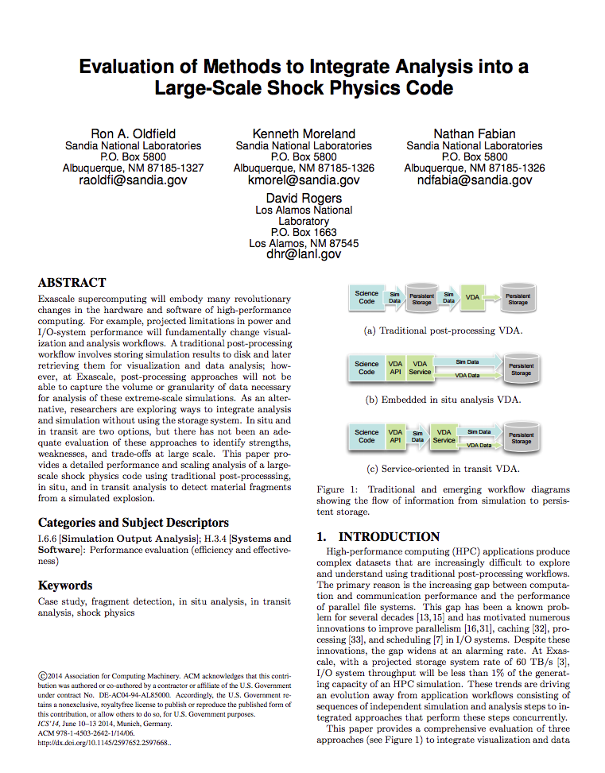
Use Case 2: Imperfect Scaling
Measures visualization algorithm
A high communication overhead severely limits scalability

Slide 43
Use Case 2: Imperfect Scaling
Notes:
If we look at a traditional plot of time, the scaling of our algorithm looks pretty good.
We see the characteristic hyperbolic-like behavior in the linear scale
And straight lines sloping in the right direction in log-log plots

Slide 44
Use Case 2: Imperfect Scaling
Notes:
But the rate and efficiency plots show a much different story
They show the scalability drops off significantly due to the communication overheads
Rate is capping off and efficiency is miserable
This algorithm clearly shows no hope of achieving isoefficiency

Slide 45
Use Case 2: Imperfect Scaling
Notes:
Looking at these together, it is hard to believe that these are all the same data
But they are, which highlights the importance of representing the data properly

Slide 46
Final Recommendations
Do not rely on running time for performance analysis. Instead use rate, efficiency, or both.
Avoid using log-log scaling on plot axes, which hides major inefficiencies. If necessary, repeat linear plots at different scales.
Rather than performing them separately, incorporate weak and strong scaling studies in one. Perform several strong scaling studies at different scales of data size. Then find an overall minimal practical cost per unit and plot all the measurements together as demonstrated in the figures in this paper.

Slide 47


Acknowledgements
This material is based in part upon work supported by the U.S. Department of Energy, Office of Science, Office of Advanced Scientific Computing Research, Scientific Discovery through Advanced Computing (SciDAC) program under Award Number 12-015215.
This material is based in part upon work supported by the U.S. Department of Energy, National Nuclear Security Administration, Advanced Simulation and Computing (ASC).

